Slide 1
CASE STUDIES
APACHE, BSD, MOZILLA, WIKIPEDIA, JOOMLA, GCC, LIBRE OFFICE

Slide 2
APACHE
Apache is an open-source web server software designed to serve web pages and web applications to users over the internet. Its primary purpose is to deliver content from web servers to web browsers.
Apache is a widely-used open-source web server software. It was originally created in 1995 by a group of developers who wanted to create a robust and scalable web server that could compete with proprietary solutions. Since then, Apache has evolved into a suite of software products that support a variety of web-related tasks, including web server software, programming languages, and frameworks.

Slide 3
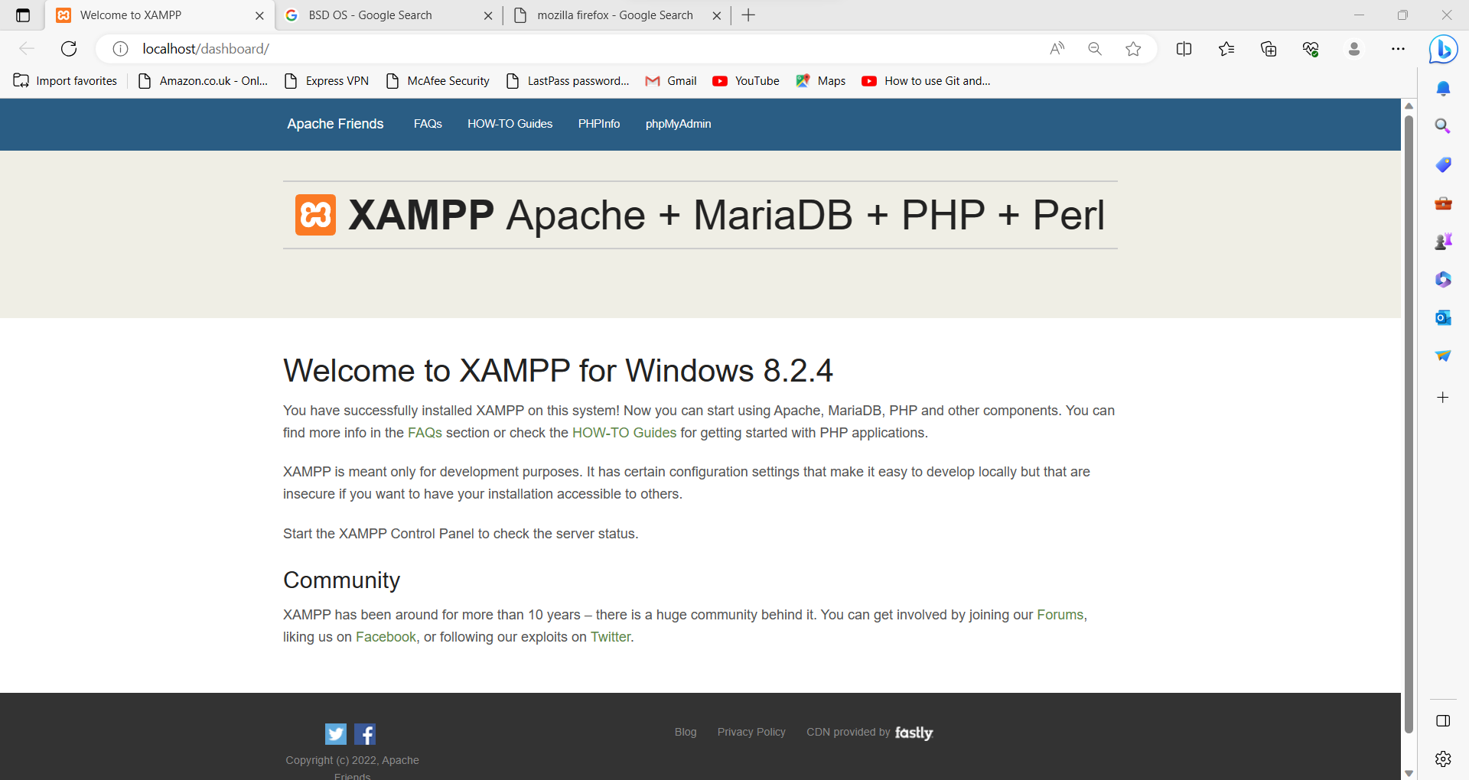

Slide 4
Berkeley Software Distribution
Berkeley Software Distribution (BSD) is a free and open-source operating system derived from the original UNIX operating system. BSD was first developed in the 1970s by researchers at the University of California, Berkeley. It was originally released as a series of patches to the UNIX operating system, which were designed to add functionality and improve performance.
BSD has been used in a variety of applications, including scientific computing, web servers, and network appliances. It has also influenced the development of other operating systems, including Linux and macOS.

Slide 5
BSD was initially developed as an add-on to the original Unix operating system. It was later developed into a standalone operating system, with various distributions created over time, including FreeBSD, OpenBSD, and NetBSD
FreeBSD, OpenBSD, and NetBSD are three main BSD distributions. FreeBSD is known for its focus on performance and scalability. OpenBSD is known for its focus on security and code auditability. NetBSD is known for its focus on portability and support for a wide range of hardware architectures.

Slide 6
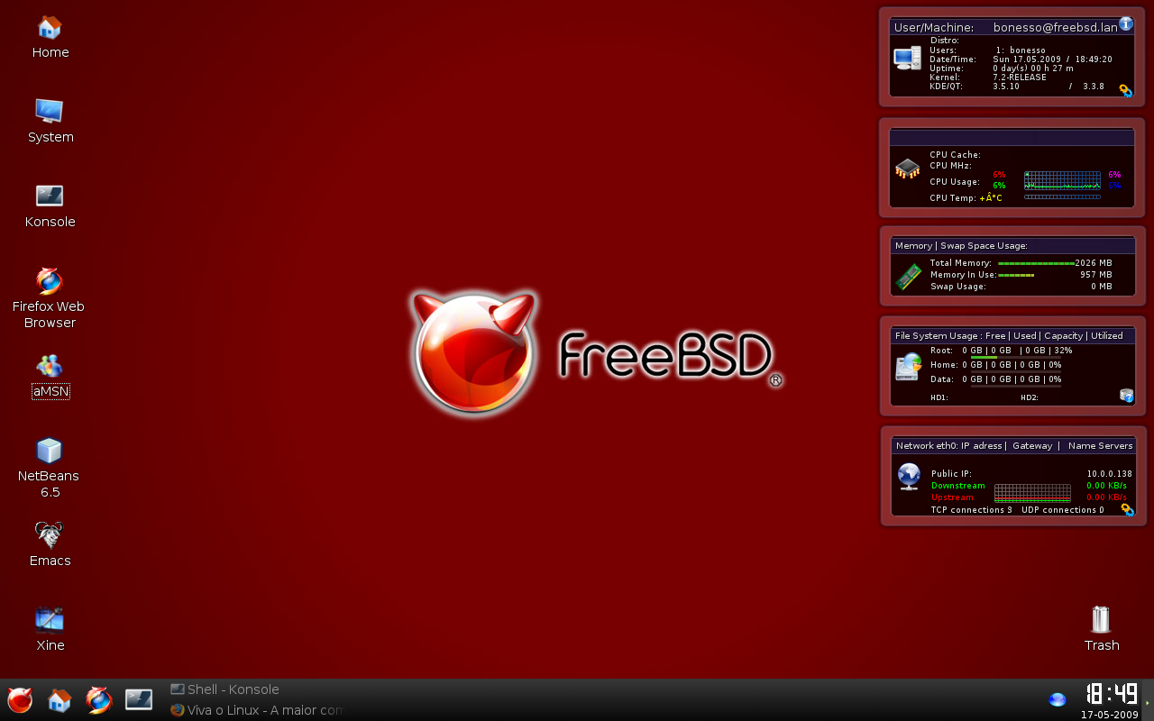
FreeBSD is known for its focus on performance and scalability

Slide 7
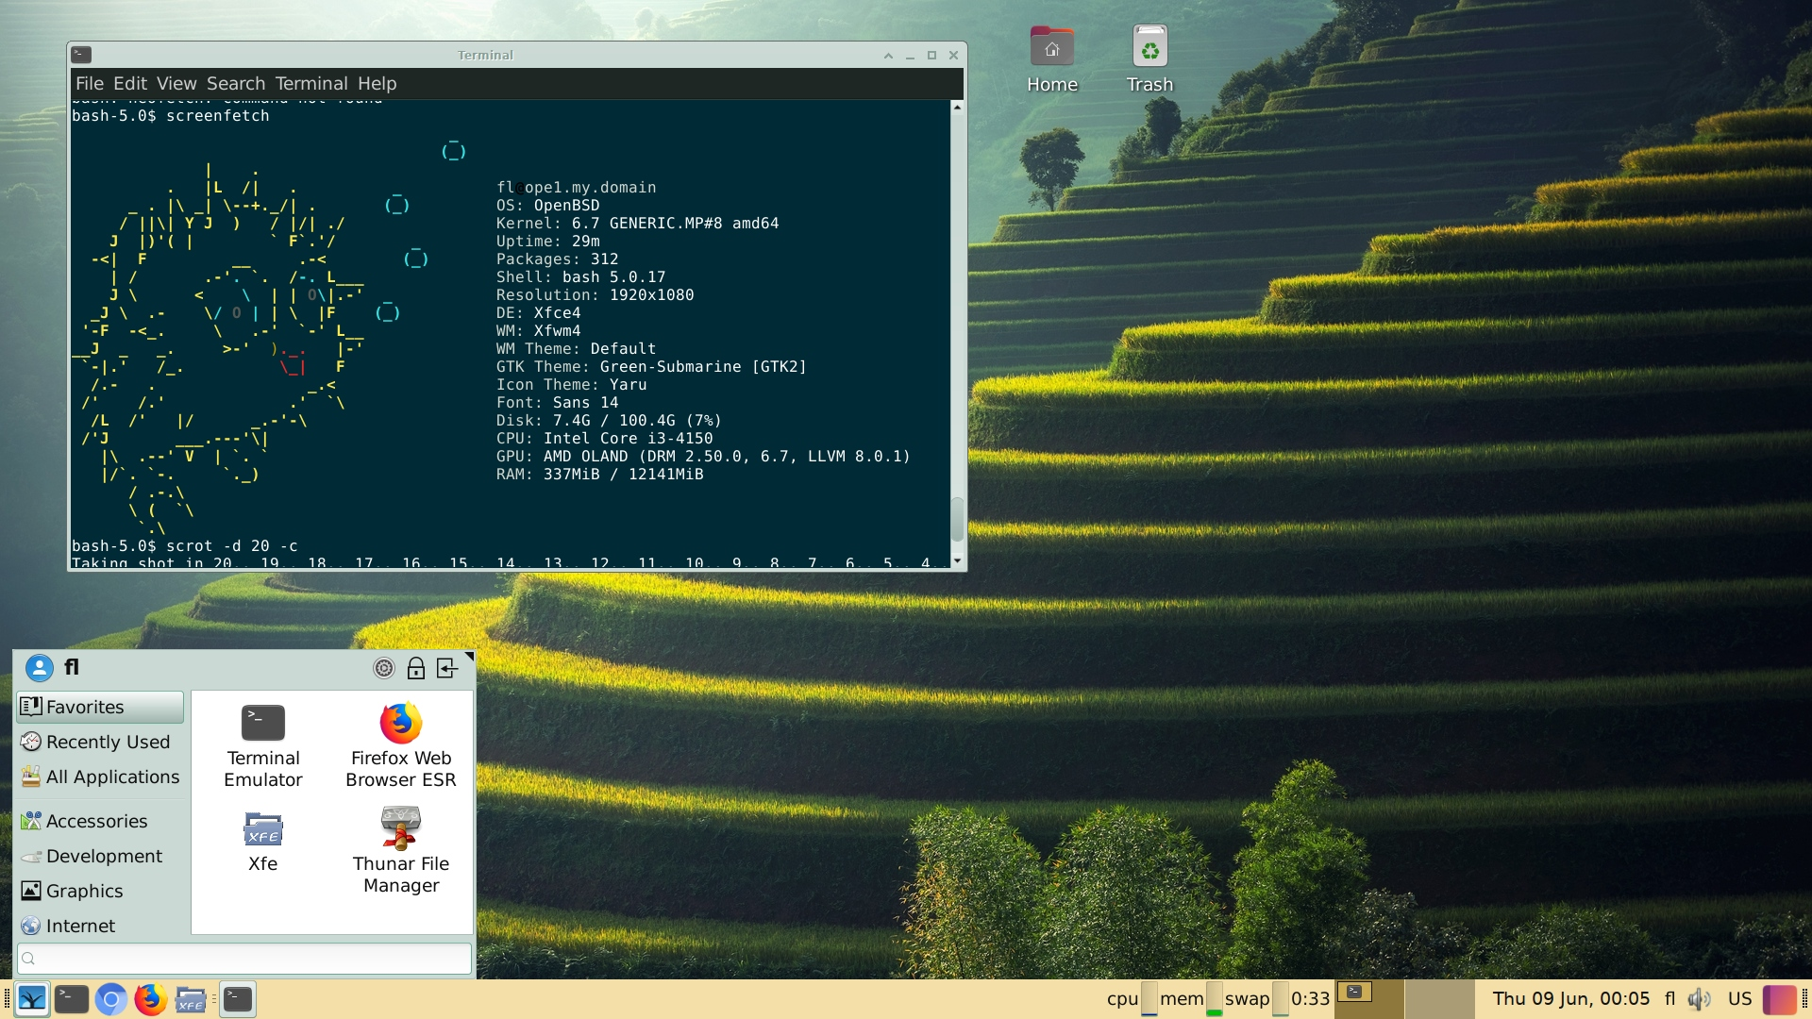
OpenBSD is known for its focus on security and code auditability

Slide 8
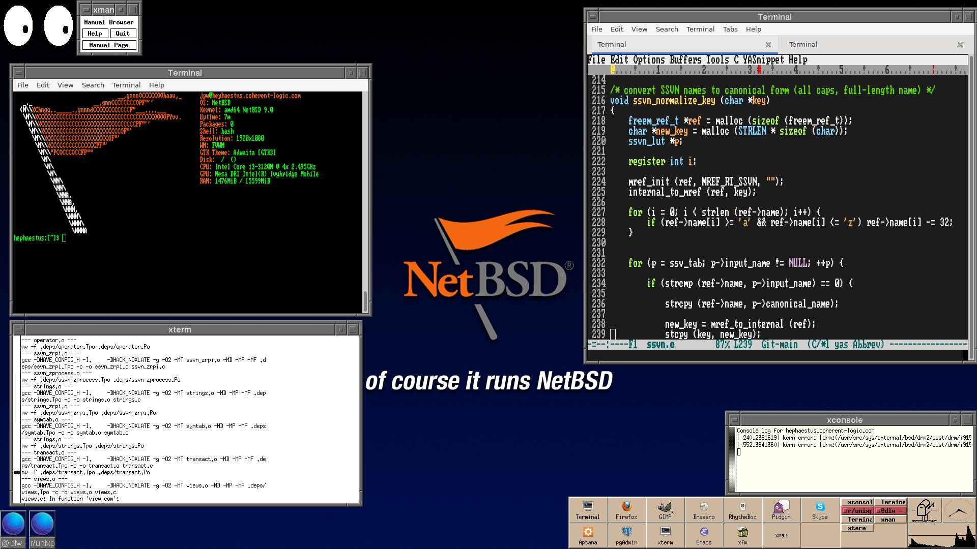
NetBSD is known for its focus on portability and support for a wide range of hardware architectures

Slide 9
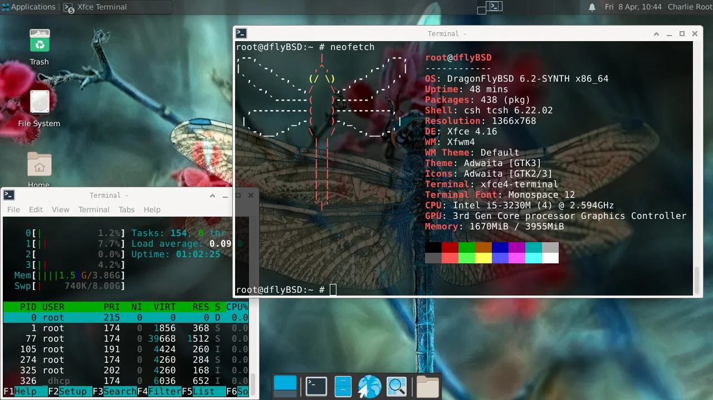
Dragonfly: It was specifically designed for server, workstation, embedded systems

Slide 10
Mozilla (Firefox)
Mozilla is a free and open-source web browser developed by the Mozilla Foundation and its community of contributors. Mozilla was created in 2002 as an open-source project to develop a web browser that would be more secure and user-friendly than existing browsers.
Firefox is the most popular web browser developed by Mozilla, and it has a large ecosystem of add-ons and extensions that allow users to customize their browsing experience. The Firefox ecosystem includes thousands of add-ons and extensions developed by Mozilla and its community of contributors

Slide 11
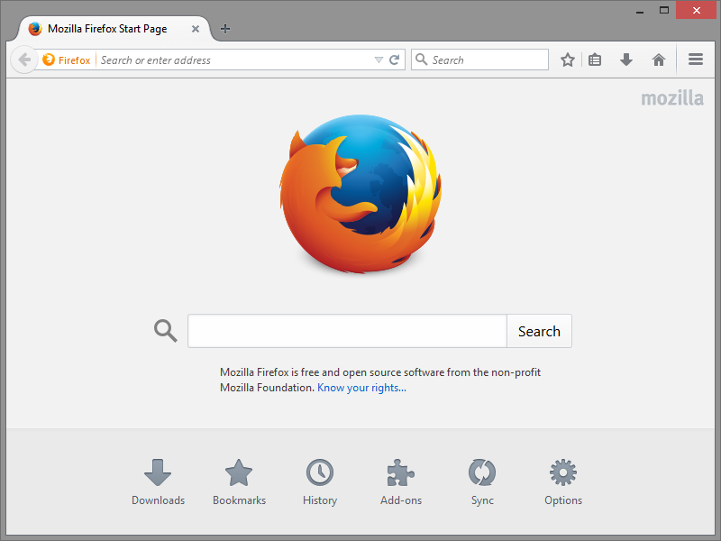

Slide 12
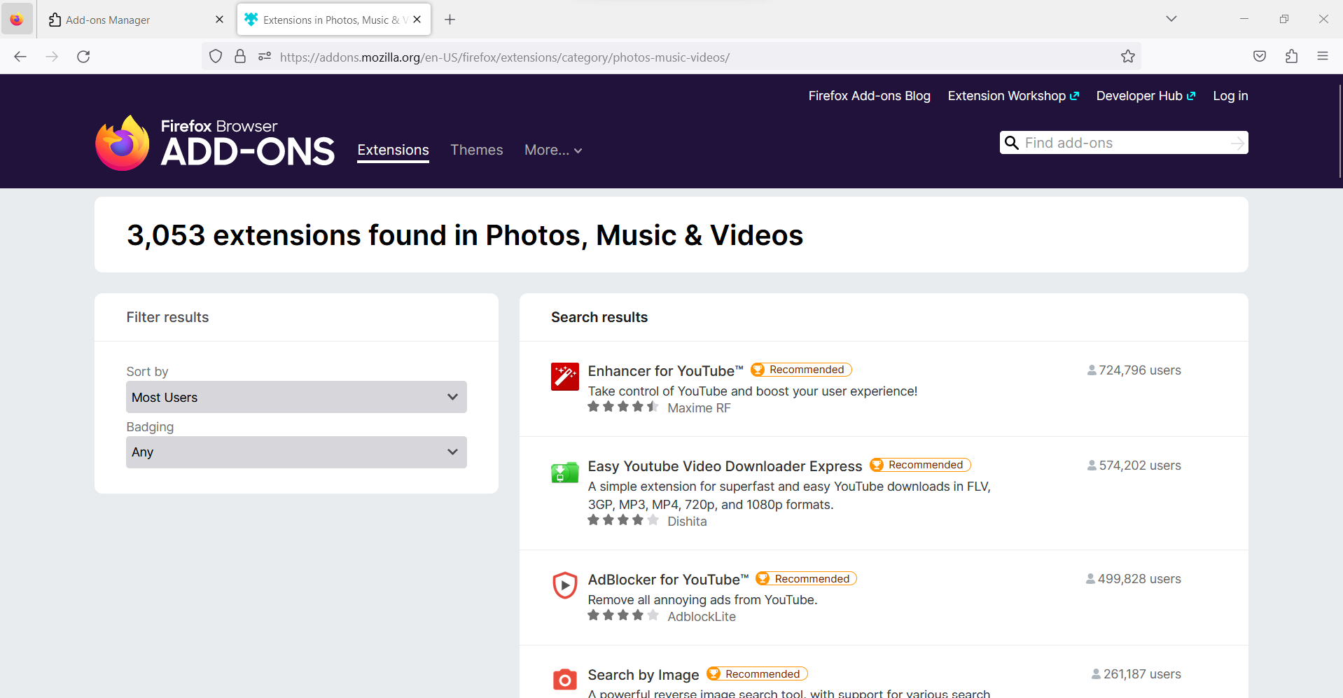

Slide 13
Wikipedia
Wikipedia is a free online encyclopedia that allows users to create and edit articles collaboratively. Wikipedia was launched in 2001 by Jimmy Wales and Larry Sanger and has grown to become one of the most popular websites in the world.
Wikipedia has had a significant impact on knowledge sharing and access, providing a free and open platform for people to access and contribute to a vast collection of articles on a wide range of topics.

Slide 14
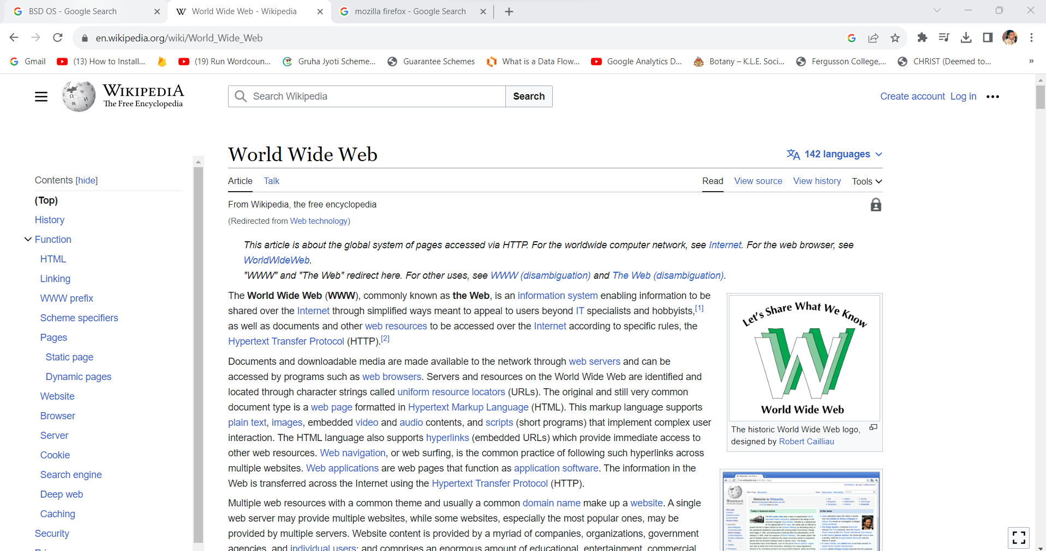

Slide 15
Case Study
Mary is a student who is writing a research paper on the topic of climate change. While doing research on the internet, she comes across a well-written and informative section on climate change in Wikipedia. She decides to copy and paste the section into her paper, thinking it would save her time and effort. Mary's teacher later informs her that she has committed plagiarism, and the section she copied from Wikipedia is not her original work.

Slide 16
Plagiarism is a serious academic offense that can lead to consequences such as failing the assignment or even being expelled from school. In Mary's case, she committed plagiarism by copying and pasting information from Wikipedia without citing it or putting it in her own words. The information she used was not her original work, and she presented it as her own
Solution:
To avoid plagiarism, students should always make sure to properly cite their sources and put information in their own words. Instead of copying and pasting information from Wikipedia, students should read and understand the information and then put it in their own words. They should also properly cite the source they used to avoid plagiarism.

Slide 17
Libre Office
LibreOffice is a free and open-source office suite that provides a powerful alternative to proprietary software such as Microsoft Office. It was launched in 2010 as a fork of OpenOffice, after a disagreement among its developers over the future direction of the project.

Slide 18
GNU Compiler Collection
The GNU Compiler Collection (GCC) is a collection of programming language compilers developed by the Free Software Foundation (FSF). GCC was created in 1987 by Richard Stallman, the founder of the FSF, to provide a free alternative to proprietary compilers.
The success of GCC can be attributed in part to its high performance, wide range of supported programming languages, and portability across multiple platforms. It has also benefited from a large and active community of developers and users, who have contributed to its development and provided support for others.

Slide 19
GCC has played a key role in the development of many open-source software projects, including the Linux operating system. Its support for multiple programming languages and multiple platforms has made it a popular choice for open-source software developers.

Slide 20
Joomla
Joomla is a popular open-source content management system (CMS) that powers millions of websites around the world. It was launched in 2005 as a fork of the Mambo CMS, after a disagreement among its developers over the future direction of the project
Joomla's success can be attributed in part to its user-friendly interface, which makes it easy for non-technical users to manage and update websites. It has also benefited from a strong community of developers and users, who have contributed to its development and provided support for others.
The Joomla community has played a key role in the success of the Joomla CMS, providing support, feedback, and contributions to the project. It has also helped to foster a strong sense of community and collaboration among developers and users.

Slide 21
